Slide 1


Webble – Android Application
By Forrest Zachary Shooster

Slide 2
WEBBLE FLOW CHART
TITLE
INSTRUCTIONS
SET FREE MODE TO ON OR OFF
GAME
PAUSE
SPIDER HEALTH = 0
WEB HEALTH = 0
RESET
LOSE THE GAME
LOSE-GAME PAUSE

Slide 3
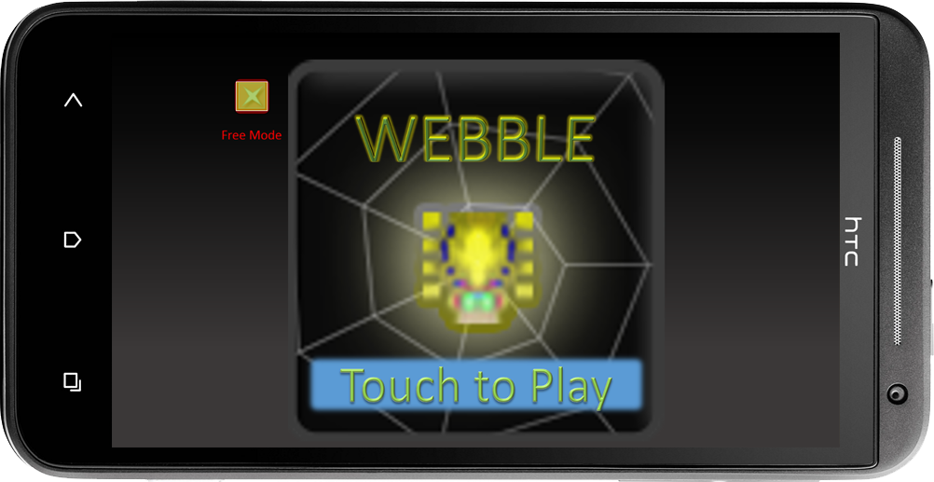
WEBBLE TITLE SCREEN
Turn on Free mode by tapping; Free Mode allows any player to continue to play forever and never lose. But no high score will be added.
Tap Anywhere Else to head to the Instructions page and start the game

Slide 4
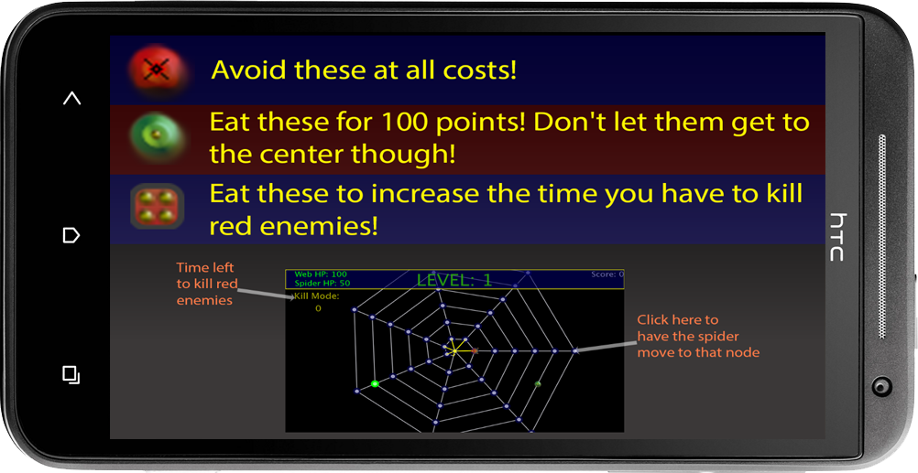
INSTRUCTIONS
Types of Enemies and Items Listed
Diagram of the general look of the game showing important parts of the in-game screen
Tap Anywhere to Start Playing

Slide 5
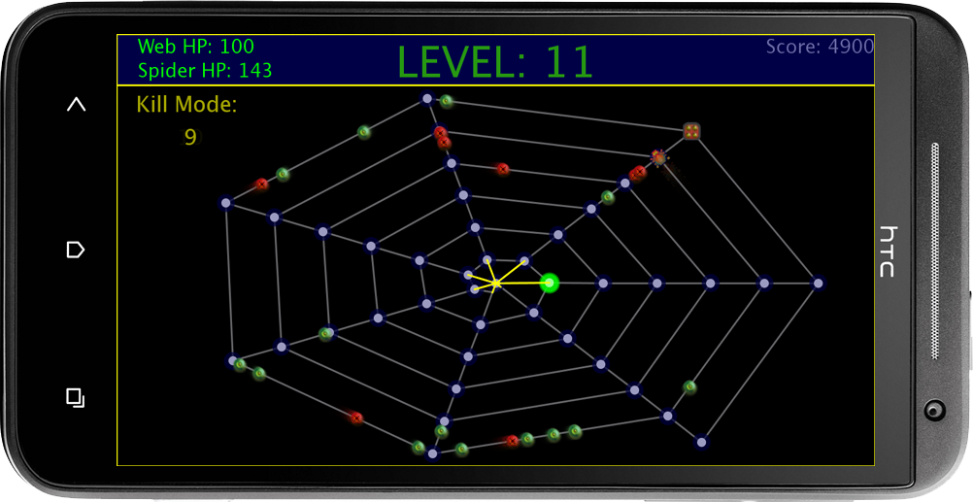
GAMEPLAY
Graphical User Interface:
Web and Spider Health
Level
Score
Kill Mode Time Left
Game Field:
Tap / Click a Node to go to it (You’re the Spider in the upper right
Follow the aforementioned instructions
For Debug Purposes currently, I am using ‘p’ and ‘r’ keys for pausing and restarting. They will be replaced with press-able buttons in the Android version

Slide 6
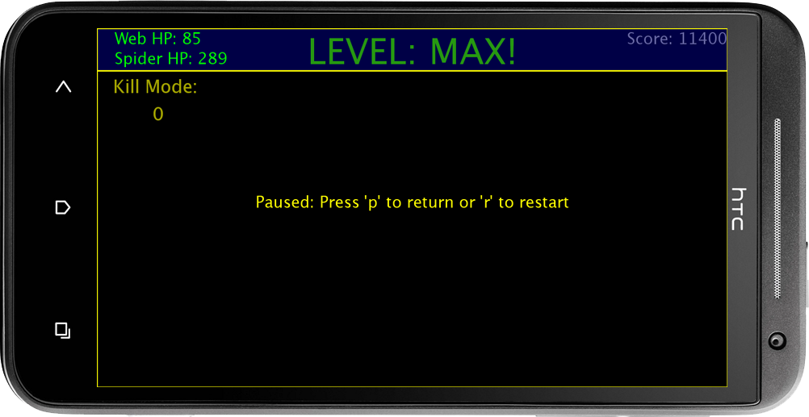
GAMEPLAY – PAUSE SCREEN
Graphical User Interface:
Web and Spider Health
Level
Score
Kill Mode Time Left
-Game Field: not visible
-GUI: visible for player convenience
-you may only restart from here or the lose screen
-press ‘p’ to return to the game
For Debug Purposes currently, I am using ‘p’ and ‘r’ keys for pausing and restarting. They will be replaced with press-able buttons in the Android version

Slide 7
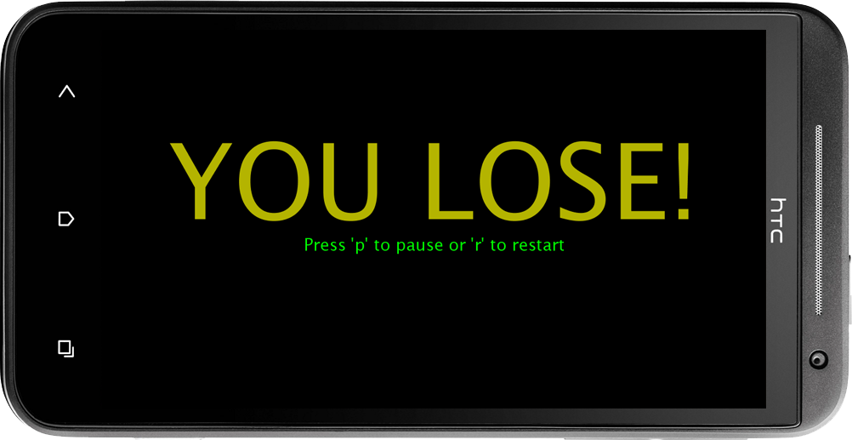
Lose Screen
You WILL NOT reach this screen if you are on free mode
Press ‘p’ to pause or ‘r’ to restart
You may only restart from here or the pause screen
GOAL: In final Android version Highscore board postings will be available from this screen. : Currently not implemented
For Debug Purposes currently, I am using ‘p’ and ‘r’ keys for pausing and restarting. They will be replaced with press-able buttons in the Android version

Slide 8
Assets
All Assets including artwork, music, code, etc. are under my ownership; no external assets were used whatsoever
Credit to Processing for providing the excellent IDE in which this program was made

